Slide 1
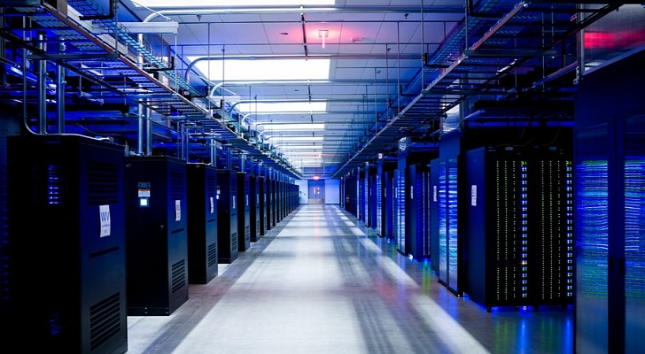

DL Workspace
Open Source Toolkit for Turn-Key AI Cluster
Notes:
We introduce DL Workspace, an open source toolkit for turn-key AI Cluster setup and operation.

Slide 2
DL Workspace is …
Open source toolkit for turn-key AI cluster setup
Used for daily development/production in Microsoft internal groups (e.g., Microsoft Cognitive Services, SwiftKey, Bing Relevance)
Allow AI scientist to run jobs (interactive exploration, training, inferencing, data analytics)
Resource managed by cluster
Turn-key operation (automatic software setup & cluster configuration)
Out-of-box support
All major DL toolkits (TensorFlow, CNTK, Caffe, MxNet, etc..)
Big data analytics (Hadoop/Spark)
Notes:
DL Workspace provides out-of-box support for multiple Deep Learning toolkit, and big data analytical kits. It is used daily by Microsoft employees, and allows AI scientist to run both interactive jobs and batch jobs on cluster.

Slide 3
Installation on Azure
Notes:
The rest of the video explains the process to install DL Workspace on Azure

Slide 4
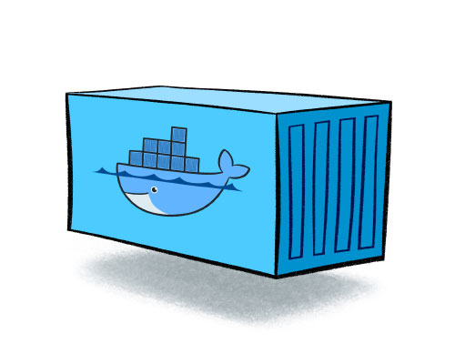
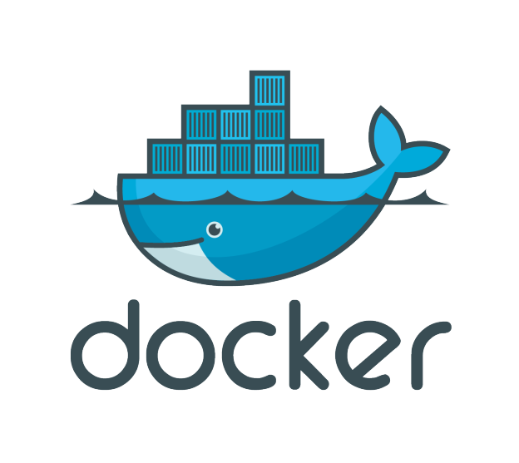

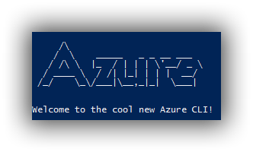
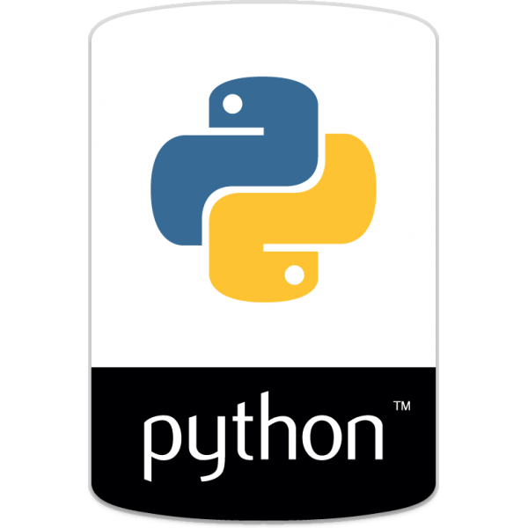
Prepare Dev Box
OR
Installation script for
Notes:
You need a development machine running Ubuntu OS. You may then either install docker, and build DL workspace dev docker, or run installation scripts that will install docker, python and Azure CLI on your machine.

Slide 5
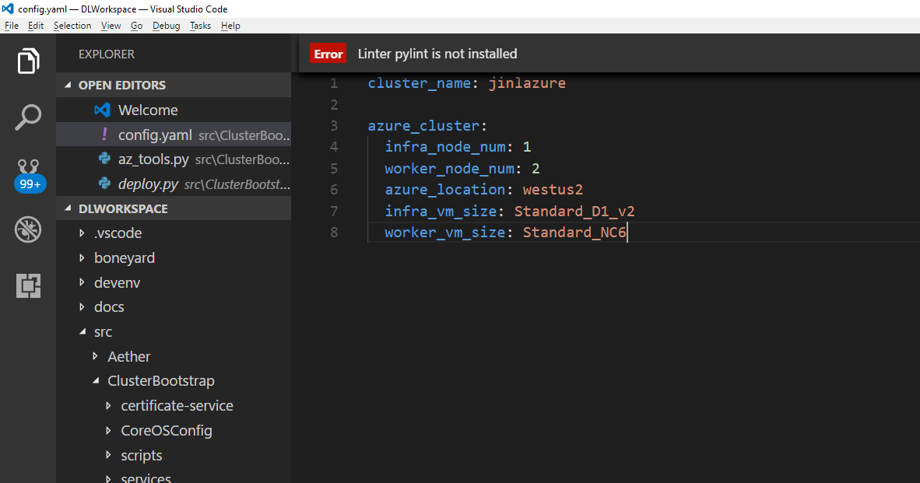
prepare configuration file src/ClusterBootstrap/config.yaml
Notes:
Prepare configuration file. You need the name of the cluster, # of infrastructure and worker node, deployed azure location, and type of VM size.

Slide 6
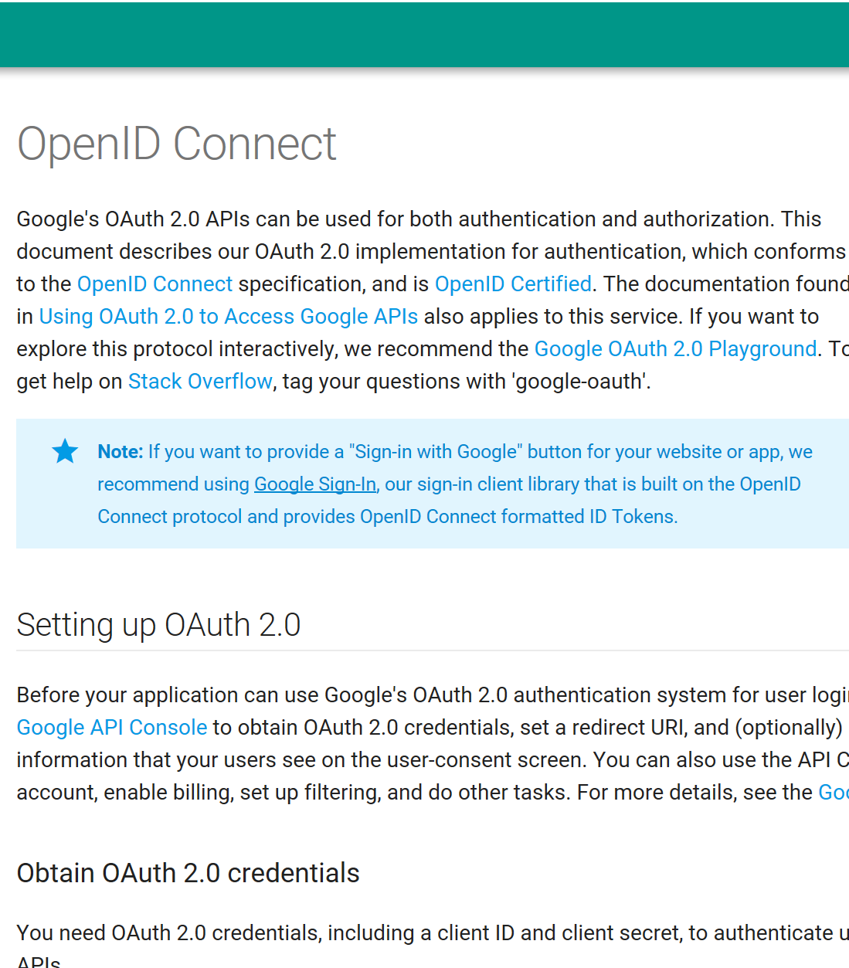
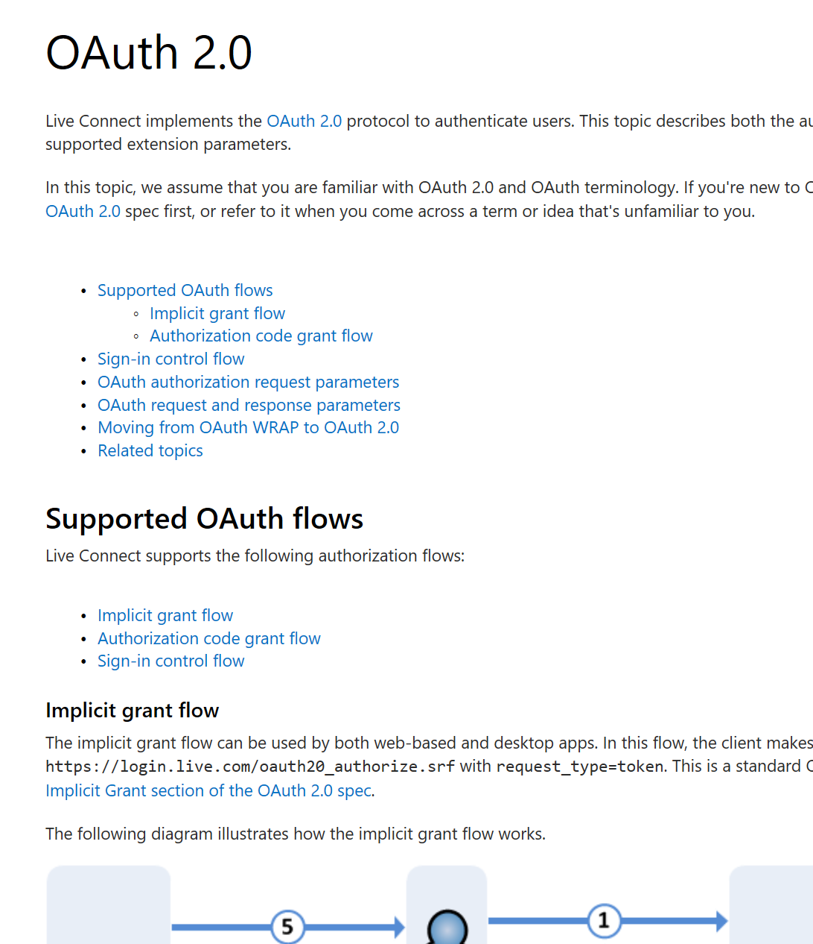
Authentication for Microsoft corp users have been pre-configured, please contact authors for information.
Notes:
Depending on your Open ID provider, configuration the Open ID endpoint, and put the information into configuration file.

Slide 7
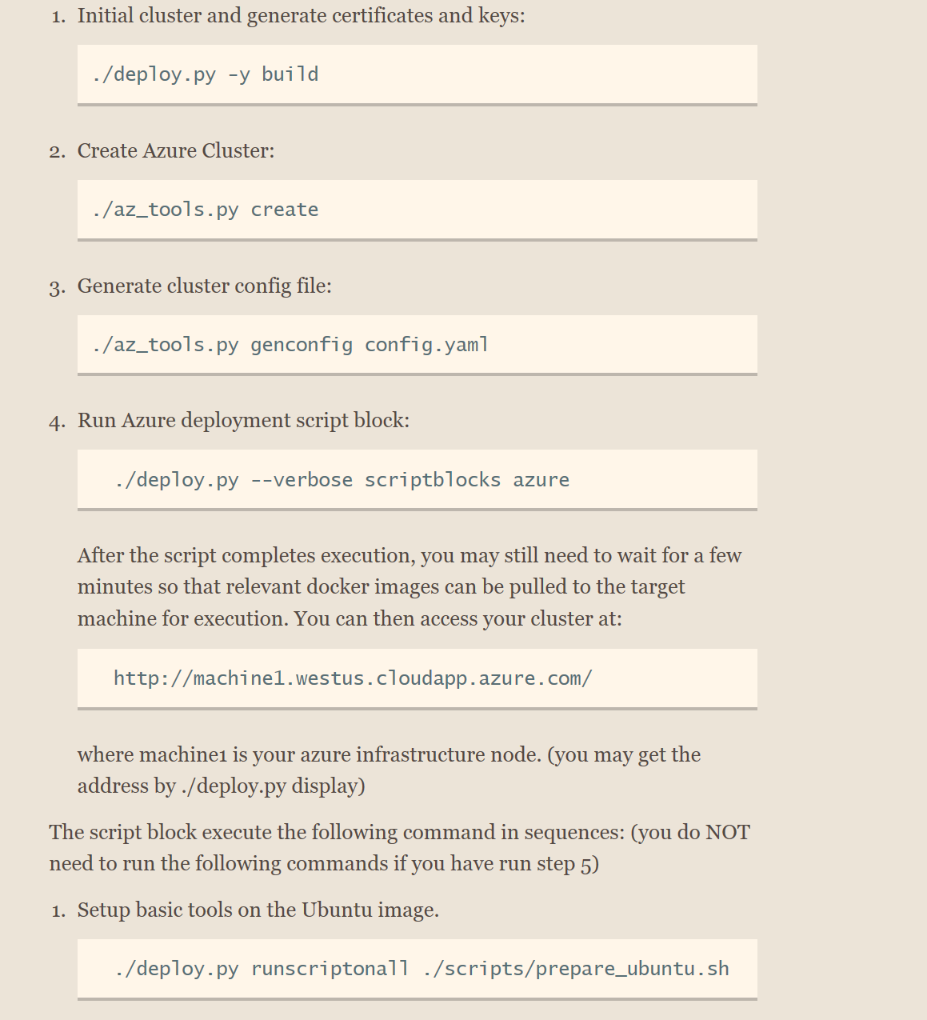
Run these scripts one-by-one to:
Generate Azure VM
Generate configuration file for the Azure Cluster
Deploy Kubernete Cluster & DL Workspace runtime
Notes:
Log in to your azure account via az login. Then run the following scripts in sequence to create Azure VM, generate configuration file for the Azure Cluster, and deploy kubernete cluster & DL Workspace runtime.

Slide 8
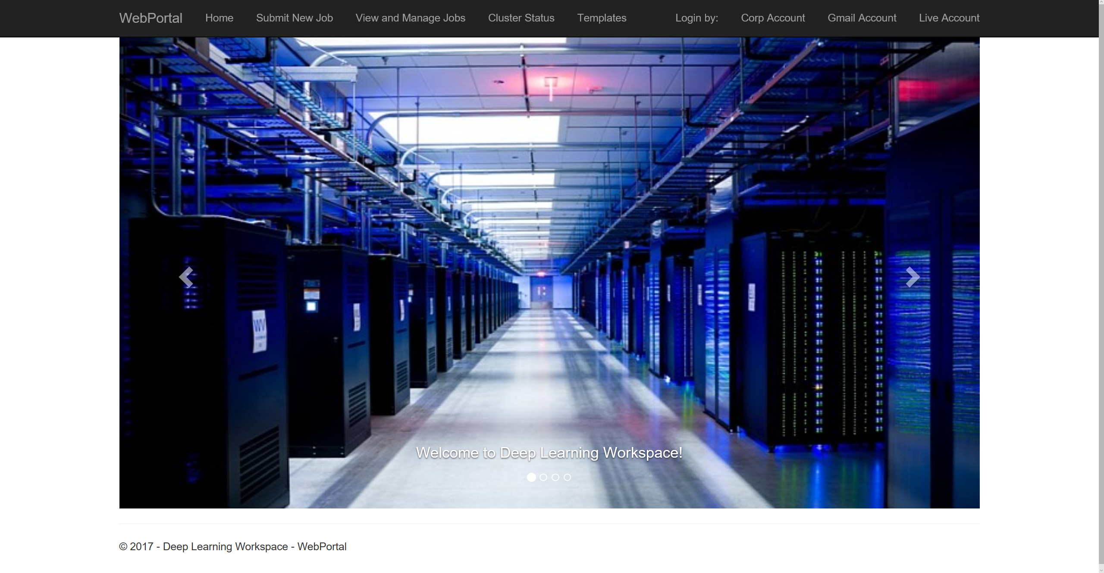
You should have a fully functional cluster in about half an hour.
Notes:
After the scripts run through, please wait a few minutes for the container to start. You should have a fully function cluster.

